Slide 1

Major Project
College Library Management

Slide 2
College Library Management
A Website To Manage College Library Books Which Can Add ,Delete, Modify And Donate Books to Library And Also List All the Available Books in the Library

Slide 3
Statement
A Header/Hero Section Displaying A Title Book Management Portal
Below Which A Input To Provide A Book name And Then below that Author name
And Then Drop Down To choose A Category Of Book And A Button to Add A Book Which Would Add A Book And List All The Books in The below Listing

Slide 4
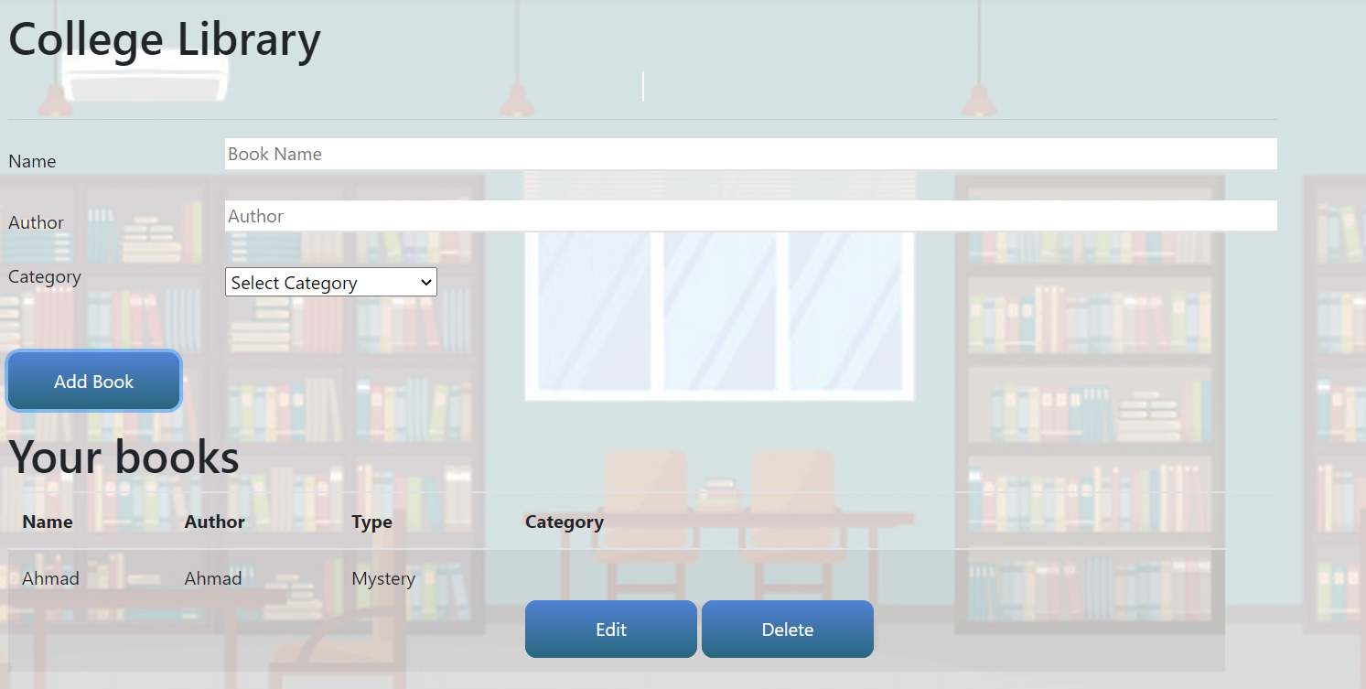
Main Page

Slide 5
Donation Page
On The Topic A Navigation Bar in Which A Link to load a donate book Page Where in Donate Book Page Will List The Following details As mentioned.
Footer Is Mandatory
And Pages Should be responsive And images to be Added For Better Visualization

Slide 6
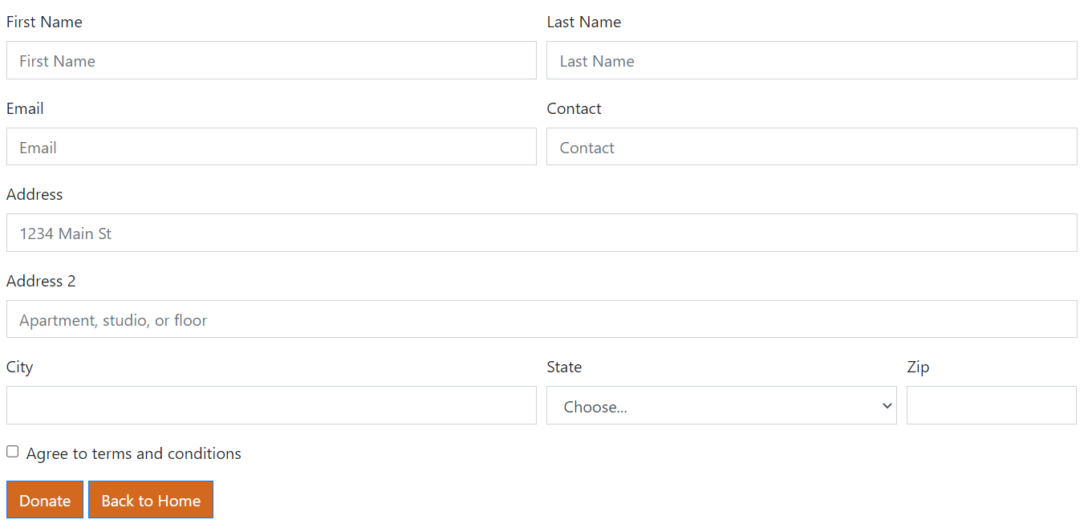
Donation Page

Slide 7
THANK YOU

